Slide 1
Digital Portfolio
STUDENT NAME: Ajay Krishnan H
REGISTER NO AND NMID:24524U50001 AND 7C8628251774B4B981C4D50E854B2CD0
DEPARTMENT: B.Sc.,(Artificial Intelligence)
COLLEGE: KARAN ARTS AND SCIENCE COLLEGE/ Thiruvalluvar University

Slide 2
Digital Portfolio
A responsive personal website built using HTML, CSS, and Javascript. Showcases skills, services, and achievements in a clean layout. Acts as a digital CV for recruiters and clients.

Slide 3


AGENDA
Problem Statement
Project Overview
End Users
Tools and Technologies
Portfolio design and Layout
Features and Functionality
Results and Screenshots
Conclusion
Github link
3/21/2024 Annual Review

Slide 4

PROBLEM STATEMENT
►Need for a personal website
►Showcase skills & services
►Easy way for recruiters/clients to know me

Slide 5

PROJECT OVERVIEW
► Responsive portfolio website
► Built using HTML, CSS, Bootstrap
► Sections : Home, About, Skills, Services, Work, Contact

Slide 6
Portfolio Sections Overview
1. Header / Navbar
Fixed at the top, with smooth scroll links: Home, About, Skills, Projects, Contact.
Mobile-friendly with a hamburger menu.
2. Hero Section
Intro: "Hi, I'm Ajay Krishnan"
Short description + profile image with floating animation.
CTA button: Get In Touch.
3. About Section
Info about AI/ML interests, academic journey, and hobbies.
Side image to balance layout.
4. Skills Section
Grid-based skill cards with icons.
Covers ML, Data Analysis, Python, Databases, Neural Networks, and Problem Solving.
5. Projects Section
Responsive grid of project cards.
Includes:
Sentiment Analysis Tool
Image Recognition System
AI Chatbot
Each has an image, description, and View Project button.

Slide 7
6. Contact Section
Left side: Email, Phone, Location, Social links (LinkedIn, GitHub, Twitter, Instagram).
Right side: Contact form with validation + alert on submit.
7. Footer
Three sections: About, Quick Links, Contact Info.
Social icons with hover animations.
Footer bottom with copyright.
8. Responsive Design
Works across desktop, tablet, and mobile.
Navbar collapses into hamburger menu.
9. JavaScript Enhancements
Mobile navigation toggle.
Auto-close menu after clicking a link.
Contact form validation + reset.
Navbar background change on scroll.

Slide 8

WHO ARE THE END USERS?
► Recruiters
► Clients
► Peers / Network
► Personal Branding

Slide 9

TOOLS AND TECHNIQUES
► HTML5
► CSS3
► JavaScript

Slide 10
POTFOLIO DESIGN AND LAYOUT
Navbar: Fixed, smooth scroll, mobile-friendly.
Hero: Intro text + profile image + CTA button.
About: Info on AI/ML + side image.
Skills: Grid cards with icons (ML, Python, etc.).
Projects: Responsive grid with project cards + buttons.
10

Slide 11
Contact: Info & social links (left), form (right).
Footer: About, Quick Links, Contact Info, social icons.
Responsive: Works on all devices, hamburger menu.
JS Features: Nav toggle, auto-close, validation, scroll effect.

Slide 12
🔹 Features
Modern UI with clean sections (Hero, About, Skills, Projects, Contact, Footer).
Responsive Design – adapts to desktop, tablet, and mobile.
Smooth Navigation with fixed navbar and scroll effects.
Interactive Sections – skills hover effects, project cards with buttons.
Contact Form – styled, with validation.
Social Media Integration – LinkedIn, GitHub, Twitter, Instagram.
🔹 Functionality
Navbar Toggle – hamburger menu opens/closes on mobile.
Auto-Close Navigation after clicking a link.
Form Validation & Reset – ensures proper input before submission.
Scroll Effect – navbar style changes when scrolling.
CTA Button – quick navigation to contact section.

Slide 13

RESULT AND SCREENSHORTS
Created a responsive portfolio website
Showcases skills, services, and achievements
Acts as a digital CV for career growth
3/21/2024 Annual Review
13

Slide 14
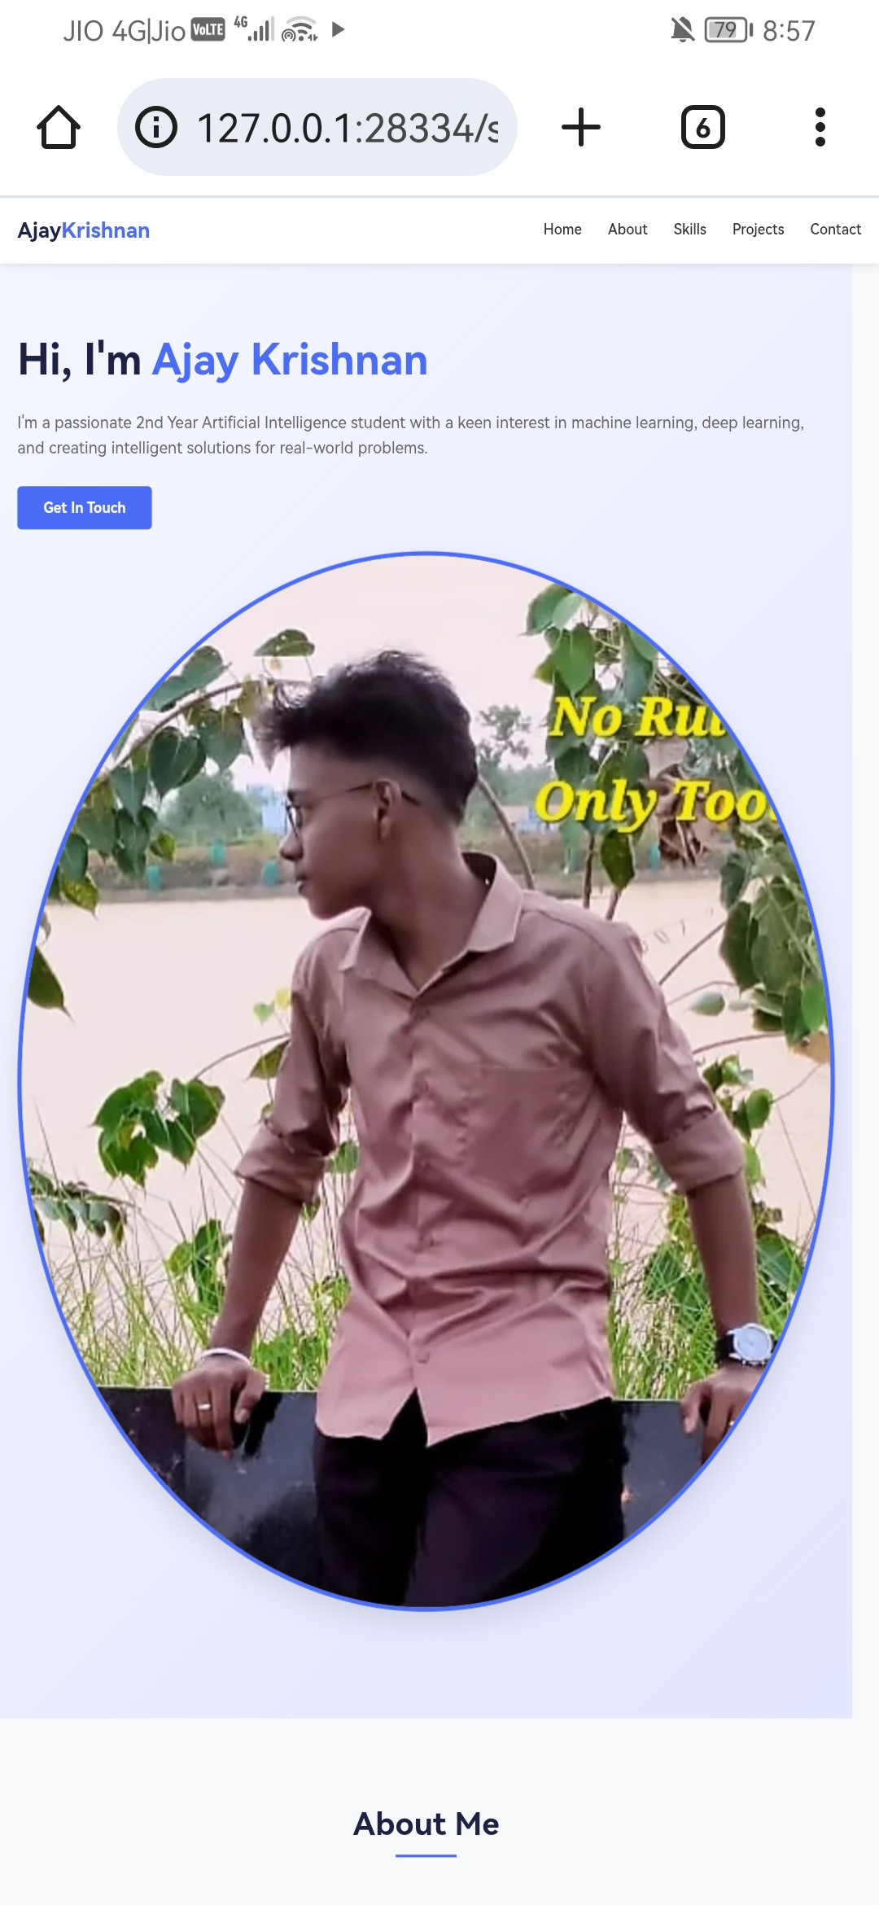
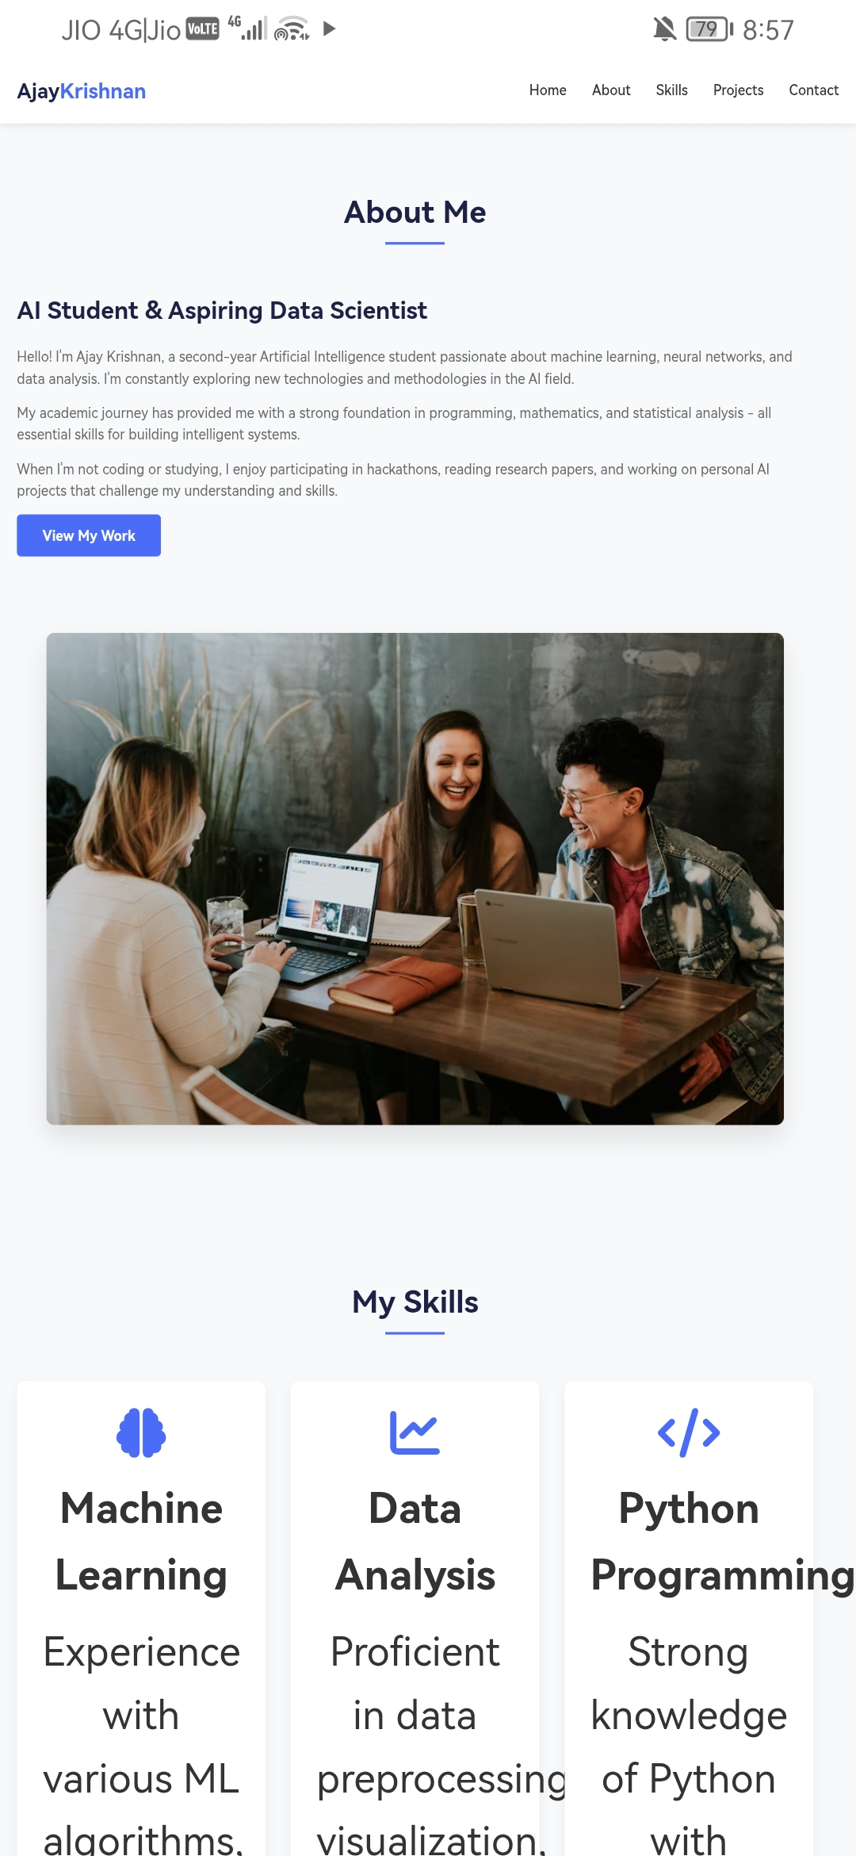
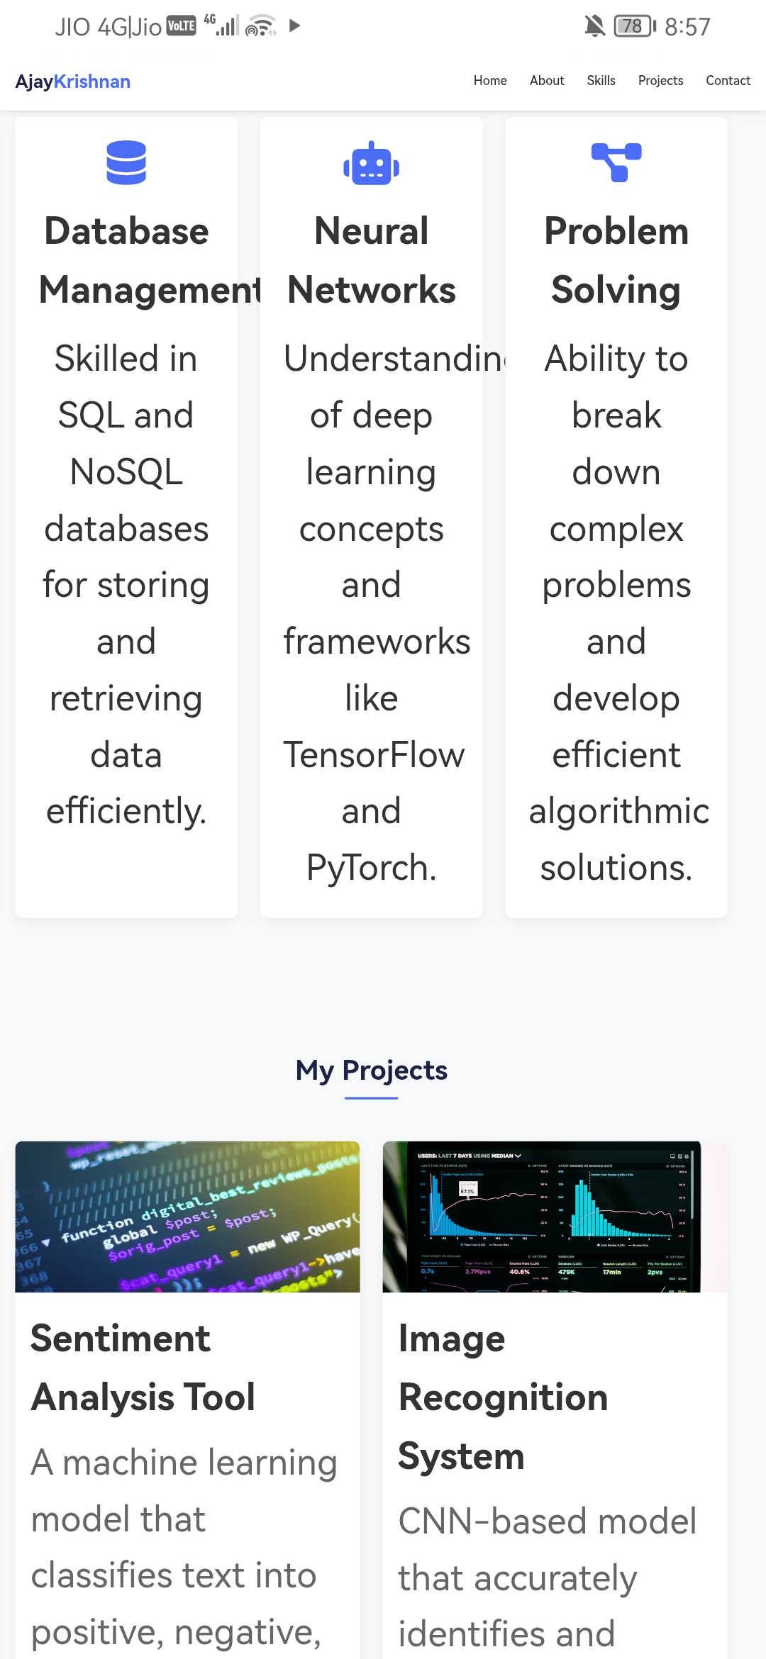

Slide 15
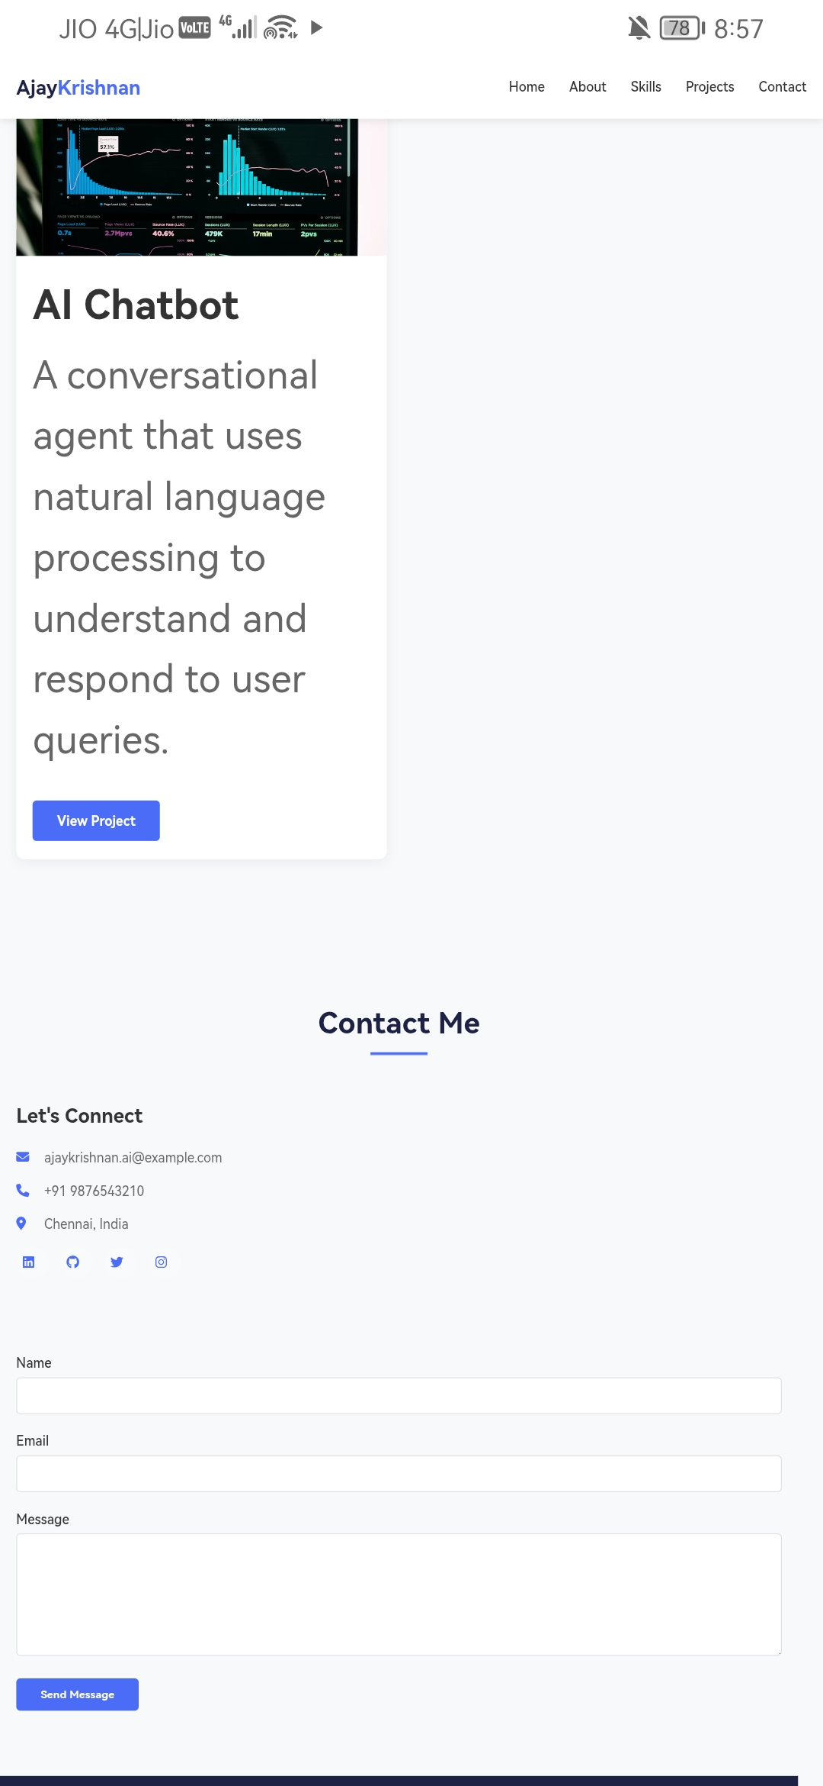
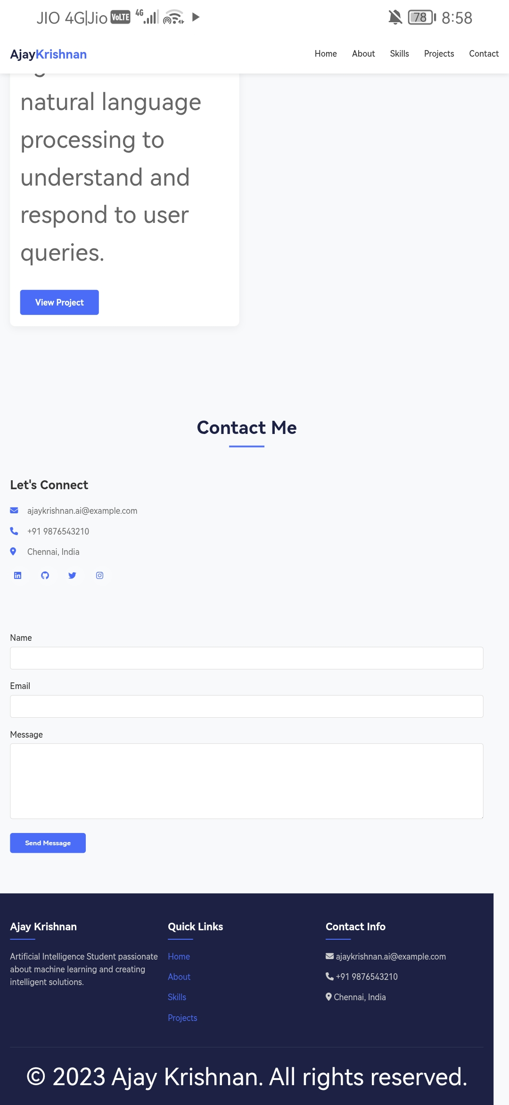

Slide 16
CONCLUSION
► Portfolio website built using HTML, CSS & JAVASCRIPT
► Showcases my skills, services, and achievements
► Helps in career growth and client reach
16

Slide 17
GITHUB LINK
https://github.com/mass123abcd-pixel/TNSDC-FWD-Ajay-Portfolio.git

